Slide 1
Professional Learning Communities-PLCs
September 16, 2014

Slide 2
Sharon Graves
Secondary ELAR/SS Coordinator

Slide 3
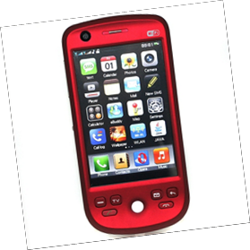
Norms
Be respectful
engage fully
actively participate
limit side conversations
Be responsible
arrive on time
leave your area clean
ready your technology
for learning
(shake don’t scream)

Slide 4
Lesson Frame-Gradual Release
I will guide you through the PLC components.
You will record your thoughts and learning.
You will collaborate concerning PLC components.
You will reflect on your own campus’ implementation of PLCs.

Slide 5
Learning Targets
I can understand PLC components
I can model and implement PLC components on my campus to impact student learning.

Slide 6
What is a good PLC?
Write your own thoughts
Share with your table
Table spokesperson share out

Slide 7
My Campus’ PLC

Slide 8
What is a Professional Learning Community?
Read introduction and conclusion
Big Idea #1
Ensure Students Learn
Big Idea #2
Culture of Collaboration
Big Idea #3
Focus on Results
Read-record individual
thoughts
Share with table
One table chart-
put on wall
Share with big idea #1 & 3 tables
Gallery walk to gather ideas from other poster groups
Read-record individual
thoughts
Share with table
One table chart-
put on wall
Share with big idea # 1 & 2 tables
Gallery walk to gather ideas from other poster groups
Read-record individual thoughts
Share with table
One table chart-put on wall
Share with big idea #2 & 3 tables
Gallery walk to gather ideas from other poster groups

Slide 9
What does a productive PLC do?
Ensures students learn-
Shifting the focus from
teaching to learning
Has a culture of collaboration-
Ongoing and meaningful
Focuses on Results-
student achievement, goals,
common formative assessments

Slide 10
CISD
Drives Planning
Is PLC time the same as planning time?
Learner Centered
Curriculum
#1
Learning standards
PLC
Meaningful Collaboration
PLAN
Activities
#2
Analyze Student Progress
Results Focused
Assessments
#3
Timely Interventions and Tutoring

Slide 11
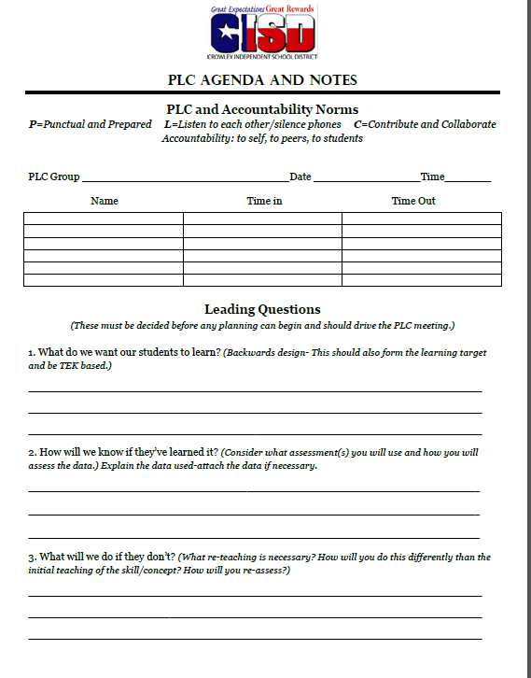
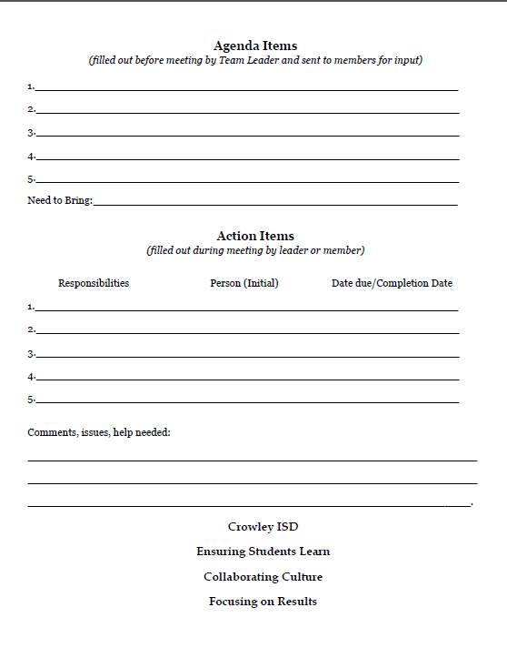
CISD PLCs
Guiding Questions
What do we want students to learn?
How will we know if they’ve learned it?
What will we do if they don’t?
Notes:
core principles-guiding questions?

Slide 13
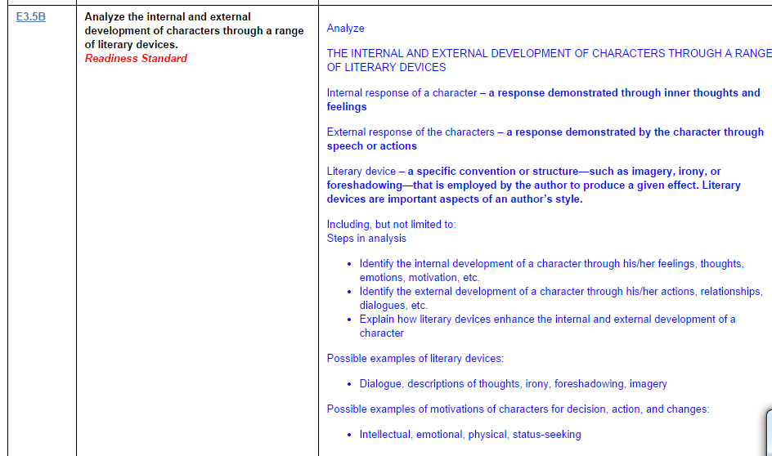

Slide 14
My Campus’ PLCs
Prescription for Improvement
Rx

Slide 15
Learning Targets
I can understand PLC components
I can model and implement PLC components on my campus to impact student learning.

Slide 16
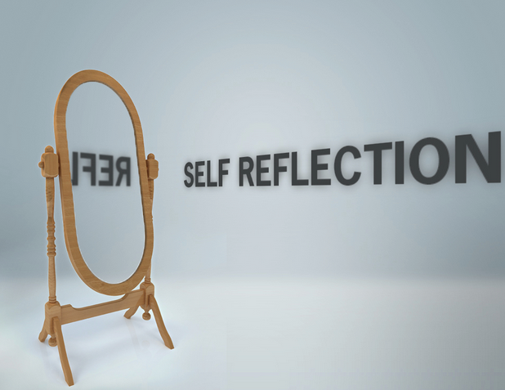
PLC
How will I ensure quality PLCs occur on my campus?
2
0
1
4
EXIT
2
0
1
5

Slide 17
Now showing….
CISD professional development survey
in Eduphoria:
5 multiple-choice questions
3 Open-ended
Reflective…
We do not learn from experience…we learn from reflecting on experience. John Dewey

Slide 18
Thank you
Sharon Graves
(817) 297-5276
sharon.graves@crowley.k12.tx.us

